Slide 1
Library Inventory System
An application designed to manage library book records, track availability, and support both admin and customer access with built-in search and CRUD functionalities.

Slide 2
Meet the Team
William Chalk – Business & User Requirements, Hardware, ER Diagram, System Context Diagram
Fredrick Nkrumah – User Experience, Wireframing, Functional & Nonfunctional Requirements, Future Development
Lauren McNeill – System Architecture, Features & Functions, System Dependencies
James Cotton – Reports, Top-Level Classes, Class Diagram
Claudia Dorin – Project Manager: Collaboration, Documentation, Security, Data Flow & Data Flow Diagram

Slide 3
Collaboration
Trello – Kanban board for Agile task management ("To Do," "Doing," "Done").
Used for assigning tasks, setting priorities, and tracking progress.
Cards include labels, due dates, checklists.
Updated regularly during sprint planning and stand-ups.
Lucidchart – Visual system design tool.
Used for architecture, DFDs, ER models, and class diagrams.
Supports real-time collaboration and version tracking.
Microsoft Teams – Central hub for communication & file sharing.
Daily messaging, video meetings, shared documentation.
Integrated with Trello and Lucidchart for seamless workflow.
Documentation -
All artifacts stored in a shared, structured Teams channel.
Uniform naming conventions enforced.
Agile-aligned: clear, concise, and value-driven documentation

Slide 4
Project Management
Agile Scrum Methodology
Emphasizes iterative development, continuous feedback, and adaptability.
Enables a quick response to changing requirements and team collaboration.
Sprint Structure
Weekly sprints with defined deliverables and priorities.
Includes Sprint Planning, bi-weekly check-ins, Reviews, and Retrospectives.
Focused on clear goals, consistent progress, and process improvement.
Task Execution with Trello
Tasks are organized on a Kanban board: To Do, Doing, Done.
Cards include descriptions, due dates, assignments, and checklists.
This system maintains accountability and visibility throughout the sprint cycle.
Team Alignment with Microsoft Teams
Platform for real-time messaging, video meetings, and document sharing.
Central hub for planning sessions, daily communication, and project documentation.
Ensures transparency and traceability across all team activities.

Slide 5
Description & Overview
Purpose:
Streamline book management for library staff and make it easy for users to search for specific titles
Core Features:
User-friendly interface for both staff and customers
Real-time book status – Instantly shows if a book is available or checked out
CRUD functionality (Create, Read, Update, Delete) for managing inventory
Book search by title, author, category, or ISBN
Design Goal:
Standalone system
Focused on the inventory of a single library (no external database integration)
Deliver a reliable, maintainable inventory tool for libraries

Slide 6
Description & Overview Cont.
In Scope:
Modern, intuitive UI – Clean and user-friendly design
Book search functionality – Find books by title, author, category, or ISBN
Book availability tracking – Real-time updates on book status
Report generation for inventory – Reports on stock and customer insights
CRUD tools for librarians – manage book records easily
Out of Scope:
No connection to external library systems
No tracking of due dates or late fees
Technical Approach:
Uses standard database practices
Built with collaboration between UX designers, front-end, and back-end developers

Slide 7
Features
Book Inventory Management: These features streamline the management of library book records and are exclusively accessible to administrators. It includes the following functionalities:
Add new book records: Allows the library administrator to input information such as the title, author, and other relevant details about new books.
Support for bulk book uploads: This feature streamlines large-scale data entry via CSV files.
Update Book Records: Enables the library administrator to change book status (e.g., available, checked out) and edit existing book details to ensure accurate and up-to-date information.
Delete Book Records: Removes outdated or redundant books from the system.
Track Book Details: Provides a comprehensive database of book metadata for easy and seamless retrieval. It also stores historical data such as lending duration and previous borrower history.
Search and Filter Options: Provide the library administrator with tools to search for books with advanced options such as title, author, publisher, genre, format (hardcover, eBook) publishing date etc.

Slide 8
Functions
Search and Status System: Advanced Search Functionality: Enable users to search for books by title, author, genre, ISBN, or publisher. Implement auto-suggestions to help users find books faster.
Filter Options: Allow users to filter books by genre, availability status, and author.
Real-Time Availability Status: Clearly indicate if a book is "Available" or "Unavailable" to minimize frustration. Display real-time book availability, including statuses such as available, unavailable, removed, or reserved. Notify users when a previously unavailable book becomes available for borrowing.

Slide 9
User Stories
Book Management: “As a library staff member, I want to add new books to the inventory, so that the library's collection is kept up-to-date.” Criteria: The system should allow staff to enter book details (title, author, ISBN, genre, and more). Expected Result: A new book is successfully added and appears in the inventory list.
User Interface “As a library staff member, I want a user-friendly interface for adding, searching, updating, and deleting books, so that I can manage the inventory efficiently without technical difficulties.” Criteria: The interface should be intuitive, visually accessible, and require minimal training. Expected Result: Staff can perform inventory management tasks seamlessly.
Book Availability “As a library staff member, I want to see the availability status of each book, so that I can inform customers about the current stock.” Criteria: The inventory list should clearly display book availability. Expected Result: Staff can quickly identify which books are available or checked out.

Slide 10
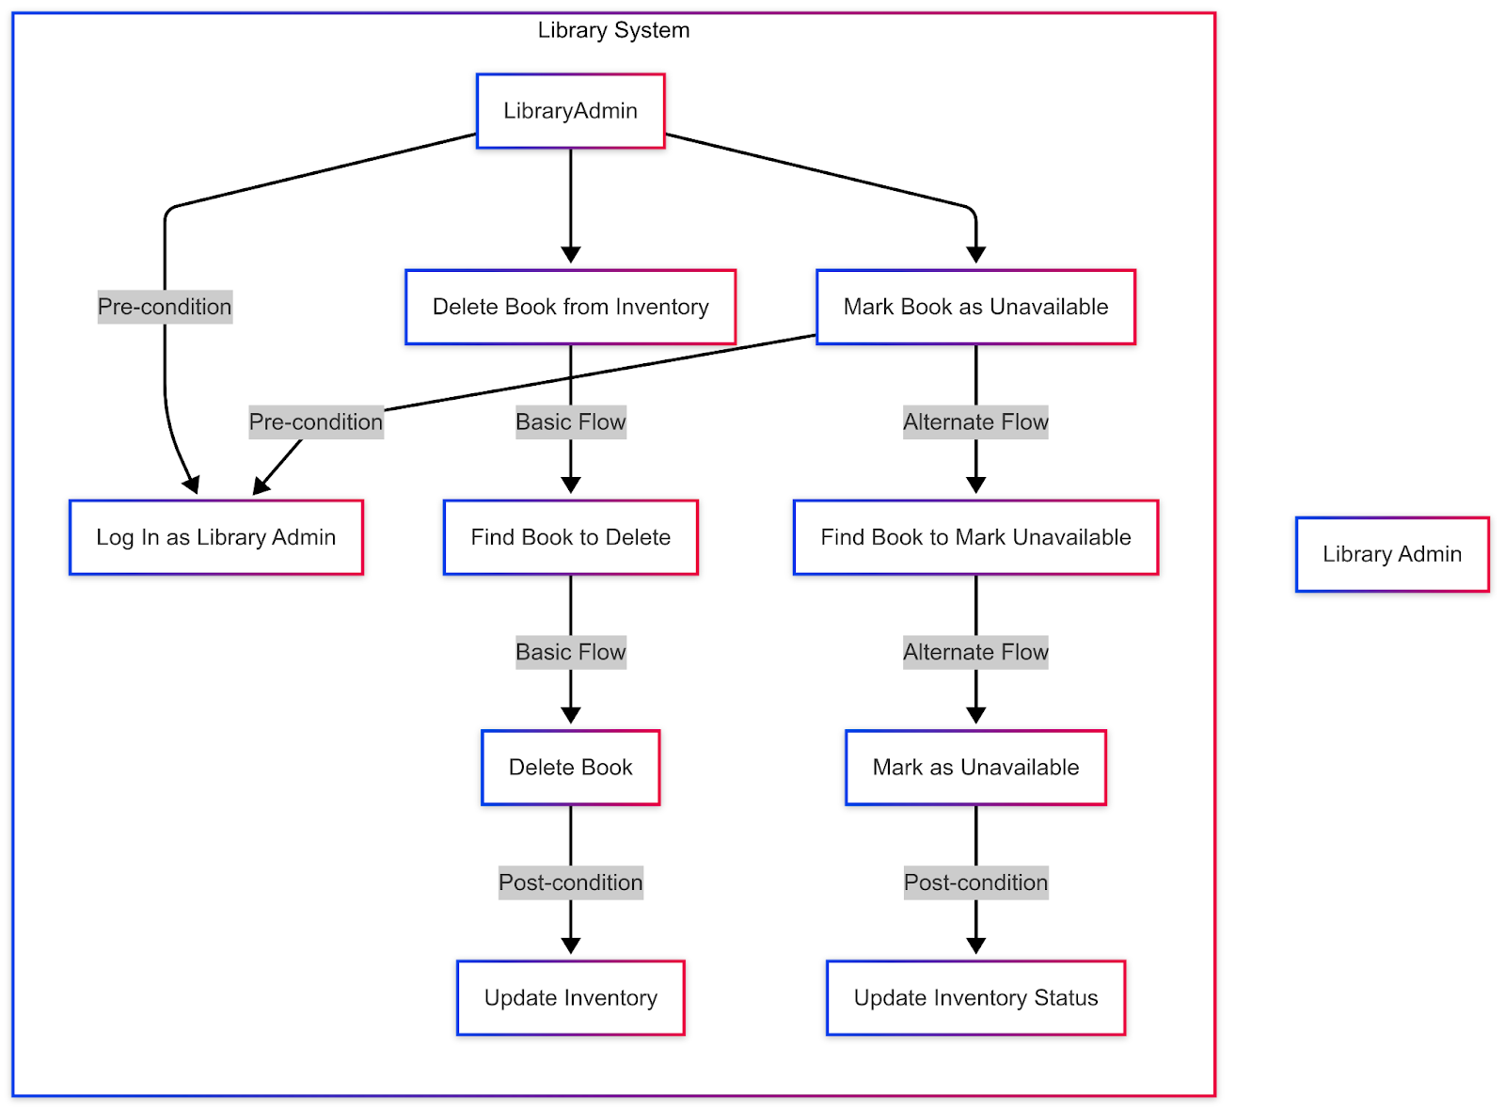
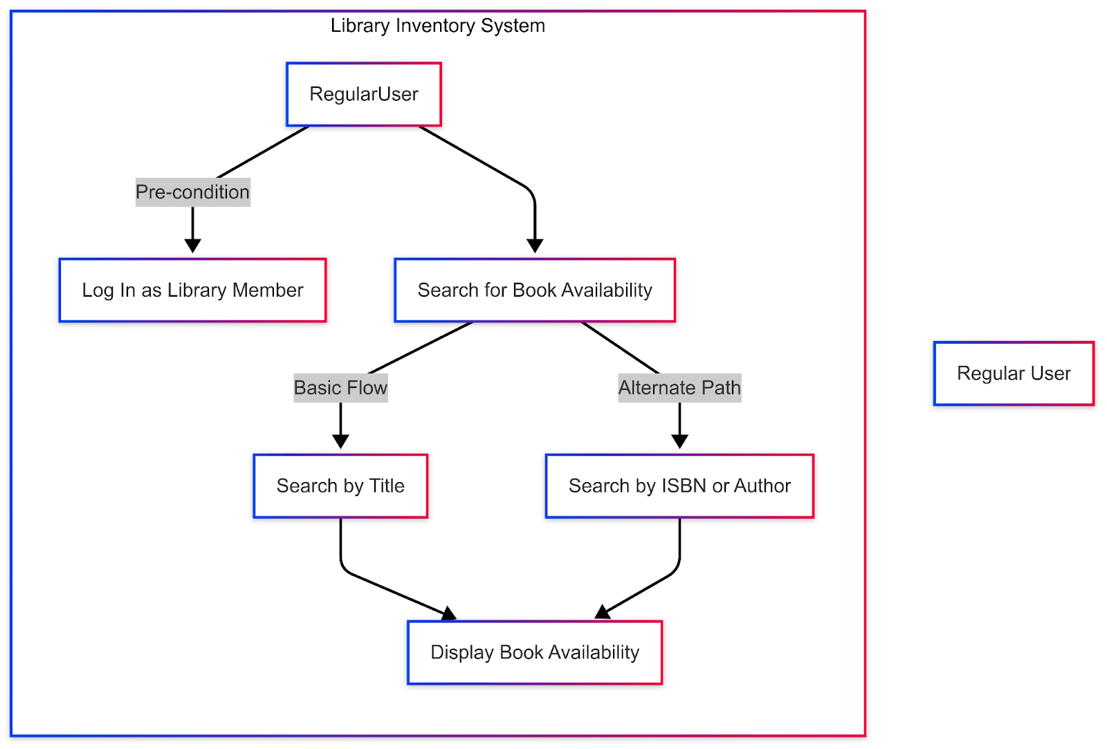
Use Case Diagrams

Slide 11
Dependencies
Database Management System (DBMS): The system utilizes a relational database (e.g., MySQL, PostgreSQL) for data storage and management.
Third-Party Libraries/Frameworks: Frameworks like Flask or Django will be used for backend development.
Operating System Compatibility: The software will be designed to work on Windows, macOS, and Linux.
External API Integration: The system will integrate with ISBN lookup APIs for book metadata retrieval.

Slide 12
Requirements Specifications
Business Requirements:
Must use relational database to store data for books and customers
Must allow libraries to generate and export a report of books based on status, author, ISBN, and title.
Should allow for late fees and due dates on books.
User Requirements:
Must provide a searchable interface that allows the users to find books by title, author, or ISBN.
Must store user email and name using industry-standard security practices.
Should allow users to view any outstanding late fees associated with their account.

Slide 13
Requirements Specifications Cont.
Functional Requirements:
Must provide user authentication mechanisms to ensure secure access.
Must allow library staff to add, edit, and delete book records in the inventory.
Non-Functional Requirements:
Must provide a user-friendly interface that allows users to complete tasks without prior training.
Must store data securely, ensuring that only authorized users can modify inventory records.
Implementation Requirements:
Application will use Python with Tkinter for building the graphical user interface (GUI).

Slide 14
HLD – System Architecture Overview
Presentation Layer (Frontend): Python Tkinter – Handles user interface & input.
Business Logic Layer (Backend): Python Django – Processes logic, manages requests.
Data Layer (Database): MySQL/PostgreSQL – Stores books, users, and checkout records.
Architecture ensures modularity, scalability, and maintainability.
User Interface
Backend API
Database

Slide 15
HLD – Module Overview with Flowchart How components interact in the system

Slide 16
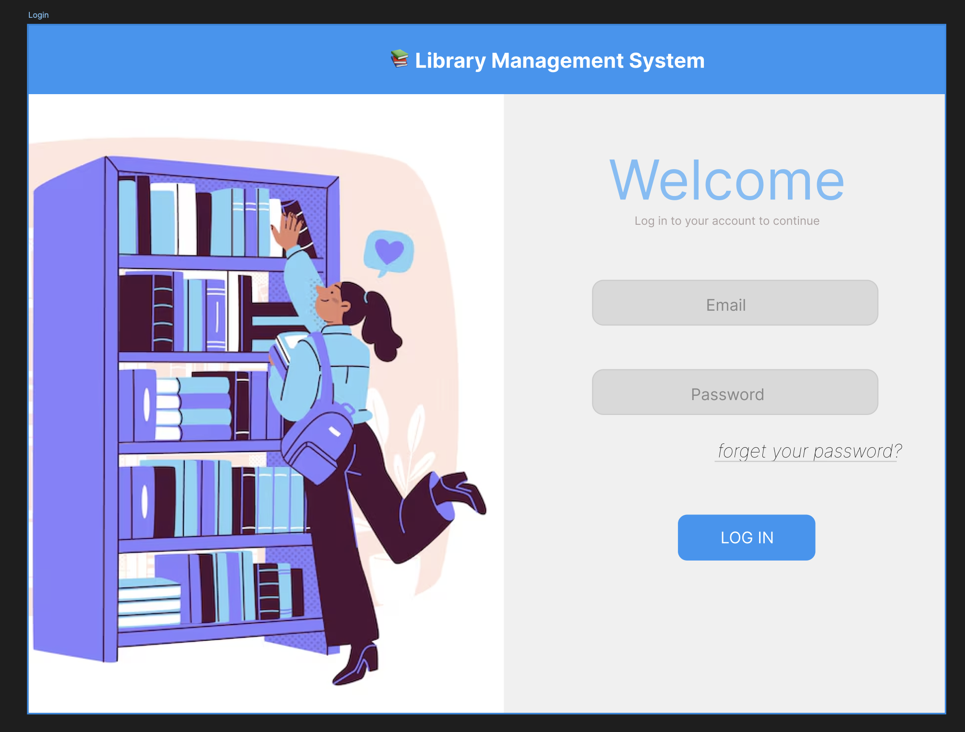
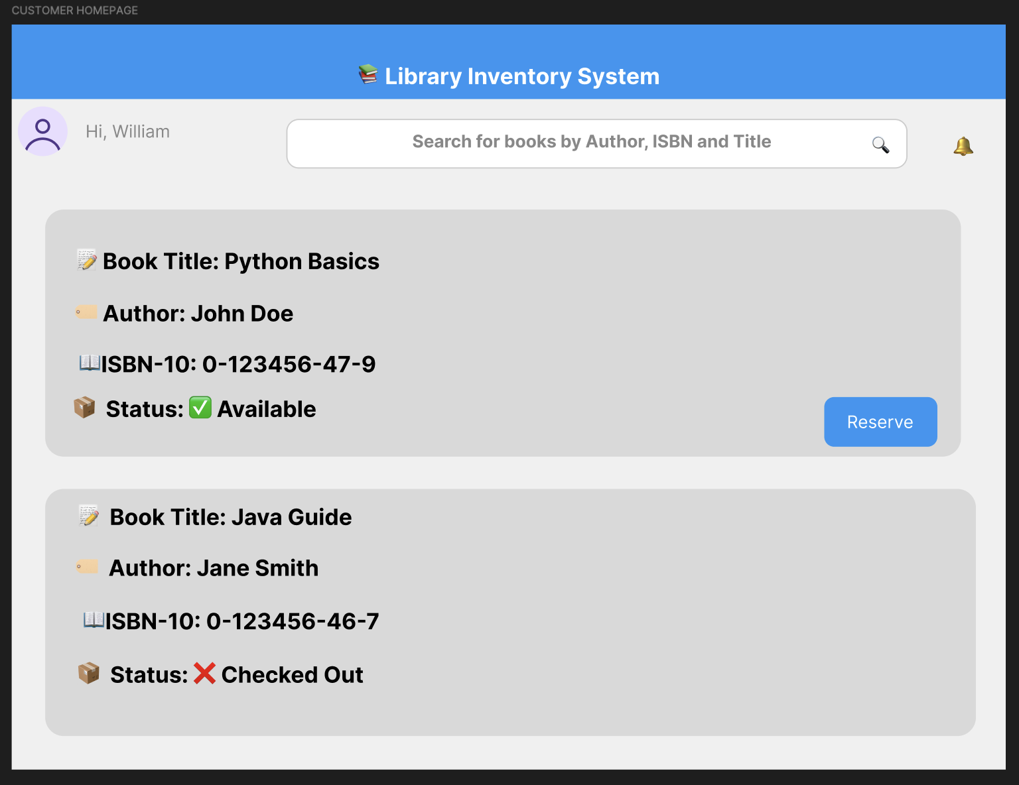
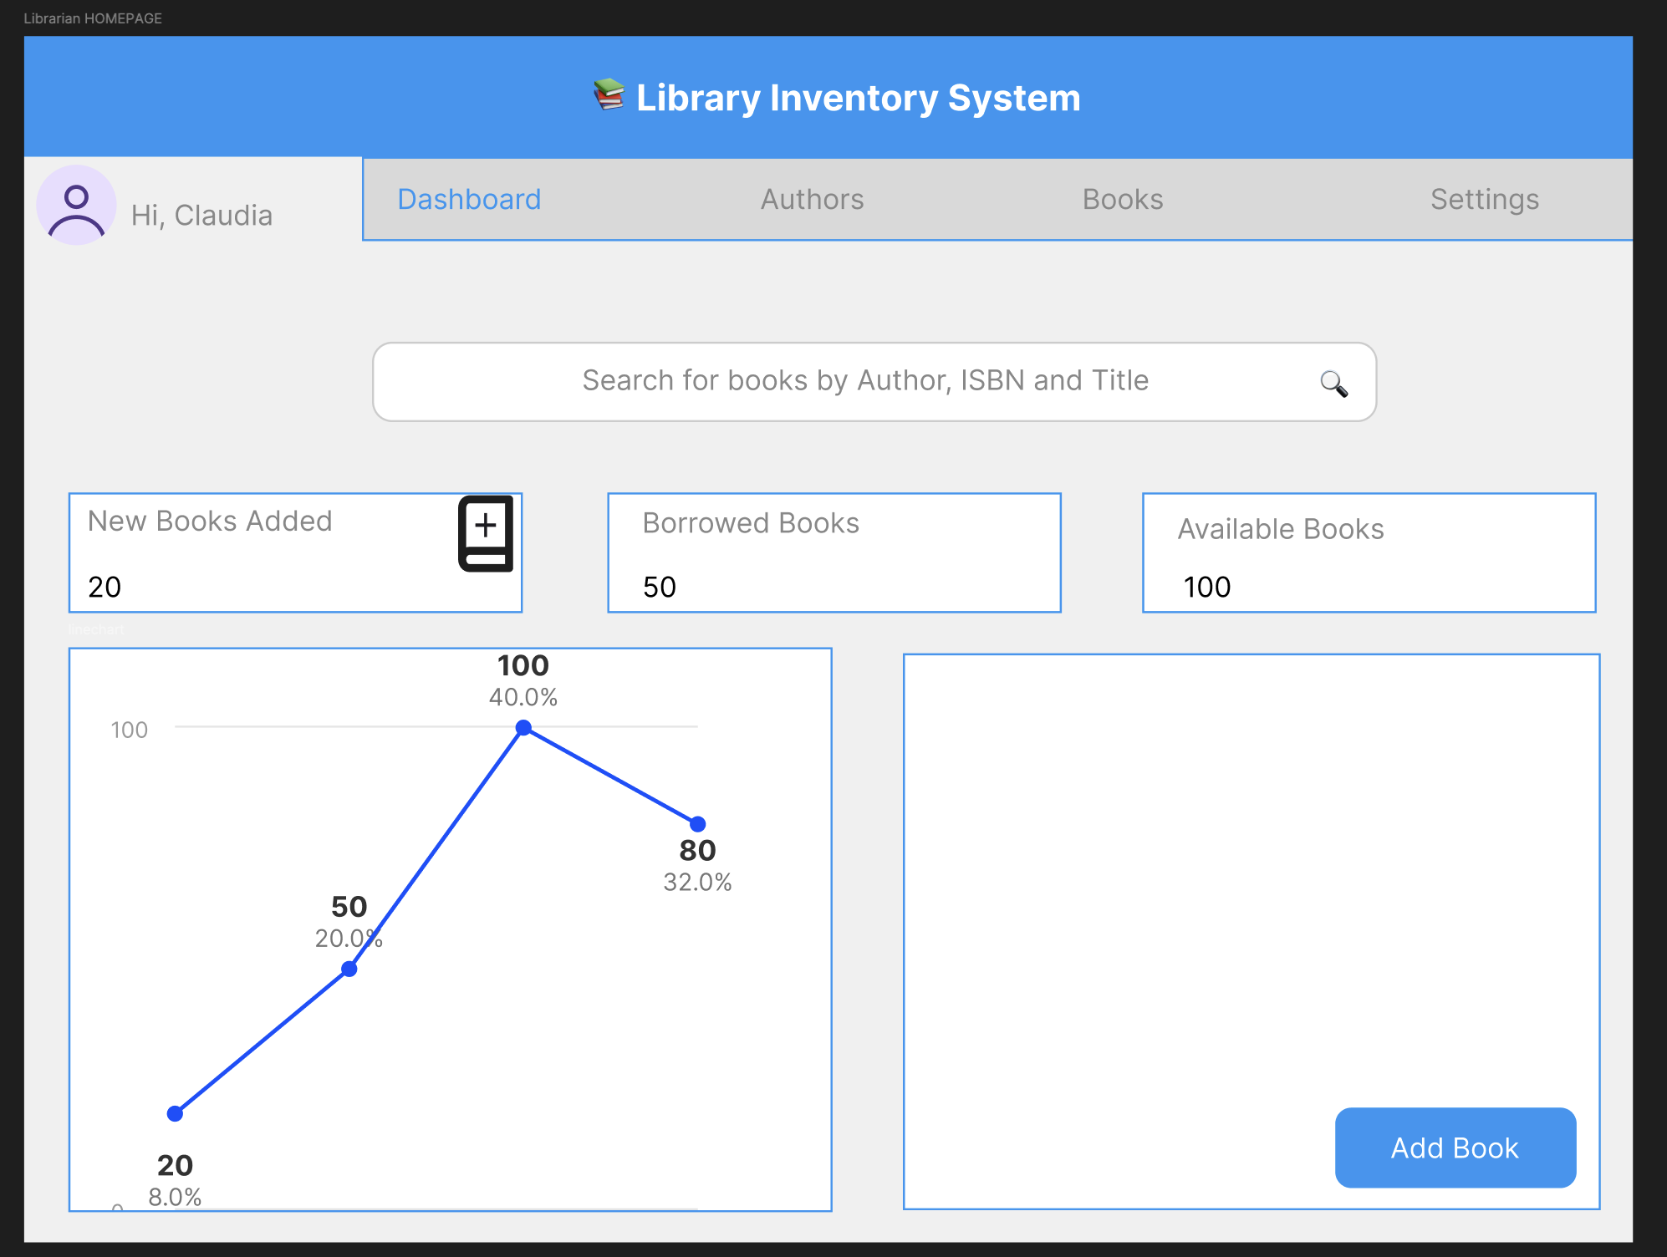
HLD – User Flow + Wireframe Snippets
Librarian → Login → Add Book → Check Inventory
Customer → Login → Search Book → Reserve

Slide 17
HLD- Secure Access Control
Role | Add/Edit Books | View Inventory | Reserve Books
Admin | ✅ | ✅ | ❌
Customer | ❌ | ✅ | ✅

Slide 18
Achievements & Challenges
Throughout this project, we accomplished several key achievements. Not only did we improve our individual skills, but we also enhanced our collective understanding of software quality as a group. Over the course of the project, we made meaningful changes and improvements to our library inventory system, striving to make it as user-friendly and efficient as possible. This project truly showcased our ability to apply what we’ve learned throughout the course in a real-world setting.
While we didn’t face many challenges, a few did arise along the way. Coordinating meeting times proved difficult, requiring us to improvise and adjust our schedules to ensure everyone could participate. Additionally, there were instances when different parts of the project didn’t align seamlessly. We often had to merge, revise, or remove certain elements to maintain clarity and cohesion in the final product. These challenges, however, helped us grow in communication, collaboration, and adaptability.

Slide 19
Future Development Plan + Q&A
Integration with external library networks
This enables users to check availability across multiple branches.
AI-Powered Book Recommendations
Recommend books to users based on their borrowing history and preferences.
Mobile app version
For easier access to search and reserve books on the go.
We would love to hear your questions!

